Slide 1
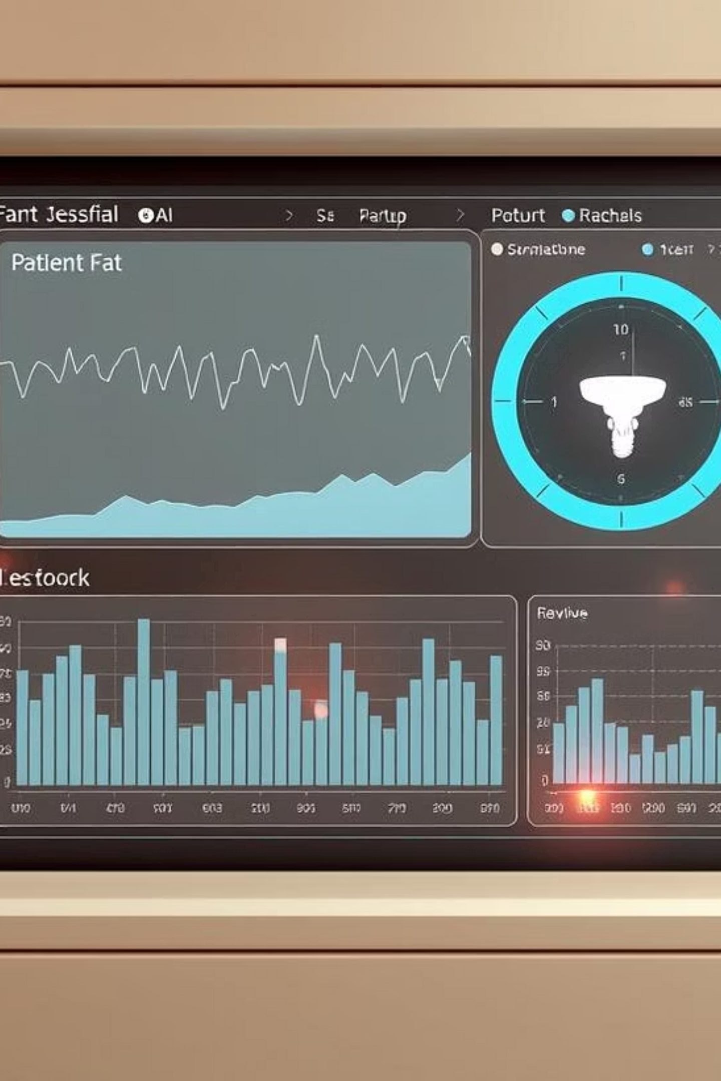
A Machine Learning Pipeline for Predicting Survival Outcomes Using Medical Data
This presentation outlines a robust machine learning pipeline designed to predict survival outcomes from complex medical datasets, aiming to provide personalized prognoses and optimize treatment strategies in clinical decision-making.

Slide 2




Project Objective
Robust Pipeline Development
Data Handling Expertise
Develop a robust pipeline for binary classification of survival outcomes.
Address class imbalance, high-dimensional data, and categorical variables.
Model Training & Comparison
Reporting & Visualization
Train and compare multiple models to identify the best performer, ensuring comprehensive evaluation.
Produce comprehensive evaluation reports and visualizations for clear insights.

Slide 3
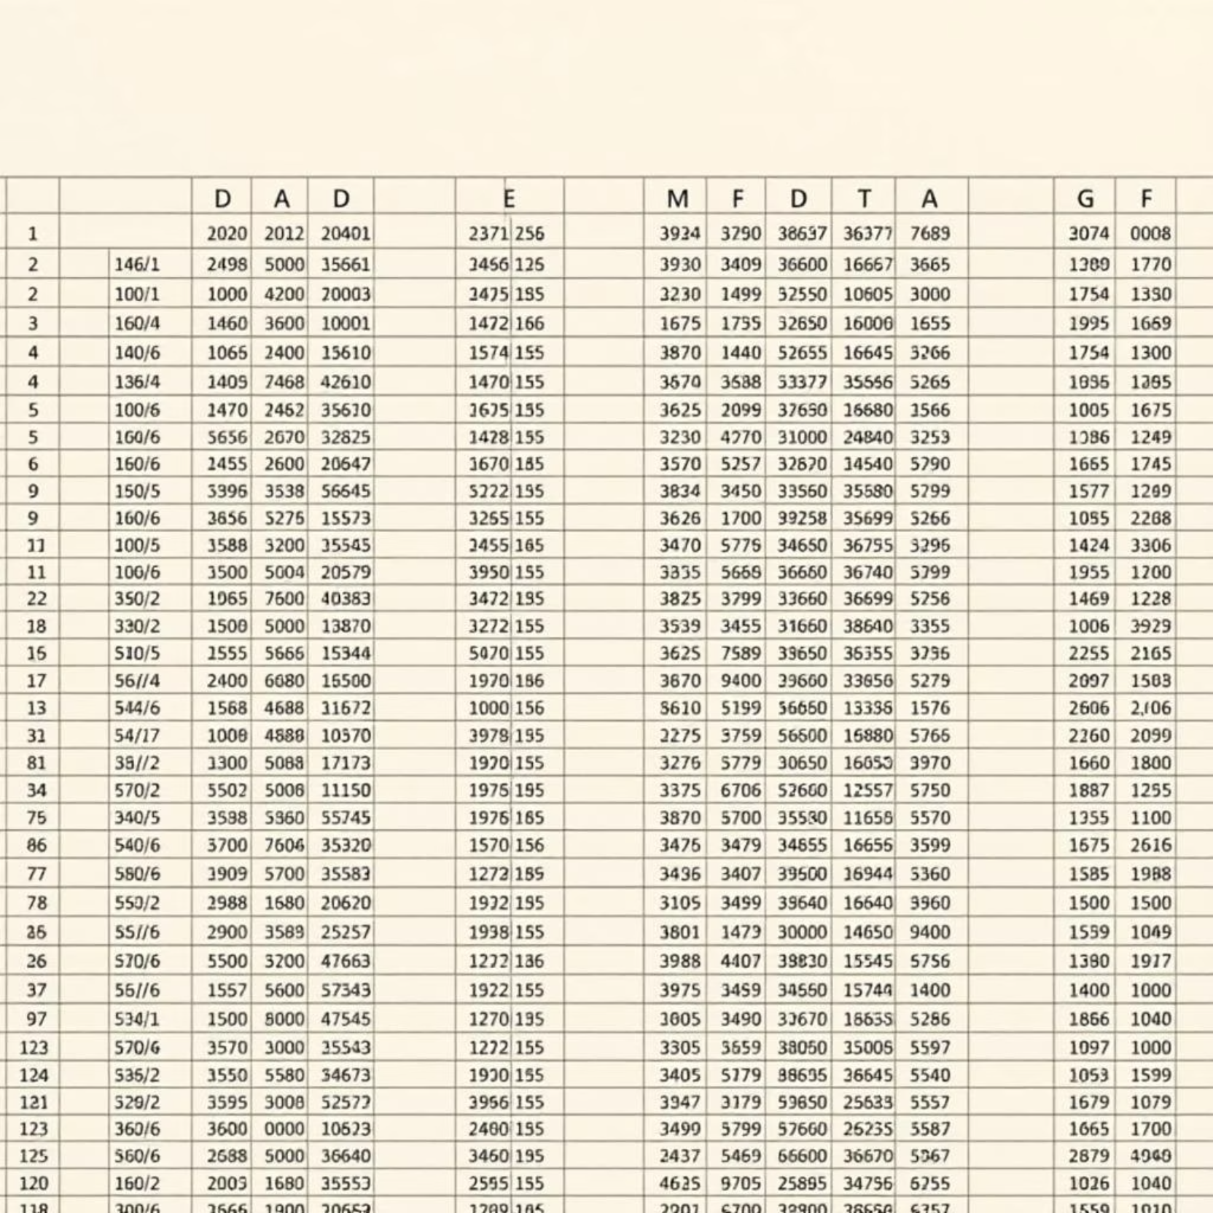
Dataset Overview
The dataset, sourced from a file named zincphosph1.xlsx, contains a single sheet named “dataset” with 66 rows and 78 columns.
The target variable, Survival (1 = Survived, 0 = Died), is highly imbalanced with 65 survived instances versus only 1 died instance.

Slide 4
Pipeline Components
Data Loading and Validation
Load and validate data from the Excel source file.
Preprocessing
Handle missing values, encode categorical variables, and remove low-variance features.
Data Balancing
Balance the dataset effectively using upsampling techniques.
Data Splitting
Split data into training and test sets using stratified sampling to maintain class distribution.
Feature Scaling
Scale numerical features to standardize their range for model input.

Slide 5

Models and Tuning
We trained three robust machine learning models: Random Forest, Logistic Regression, and XGBoost, each selected for its strengths in classification tasks.
Hyperparameter tuning was performed using RandomizedSearchCV, optimizing for the F1-score to ensure optimal performance, especially given the class imbalance.
Cross-validation utilized 5 stratified folds, ensuring robust evaluation across various metrics including accuracy, precision, recall, and F1-score.

Slide 6
Evaluation Results
100%
100%
100%
Random Forest F1-Score
Logistic Regression F1-Score
XGBoost F1-Score
All three models achieved perfect performance on the balanced test data, with F1-scores of 1.0. This indicates the pipeline effectively handled the severe class imbalance and preprocessing challenges, demonstrating excellent model fit.

Slide 7

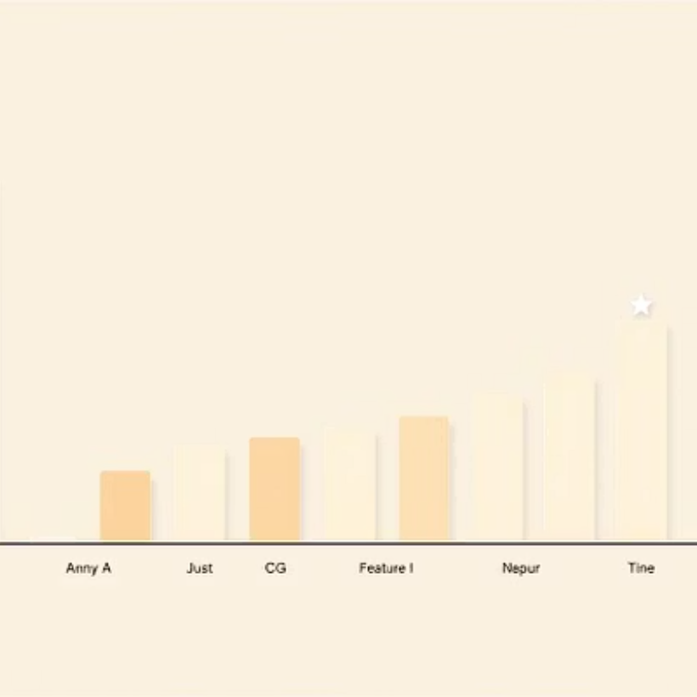
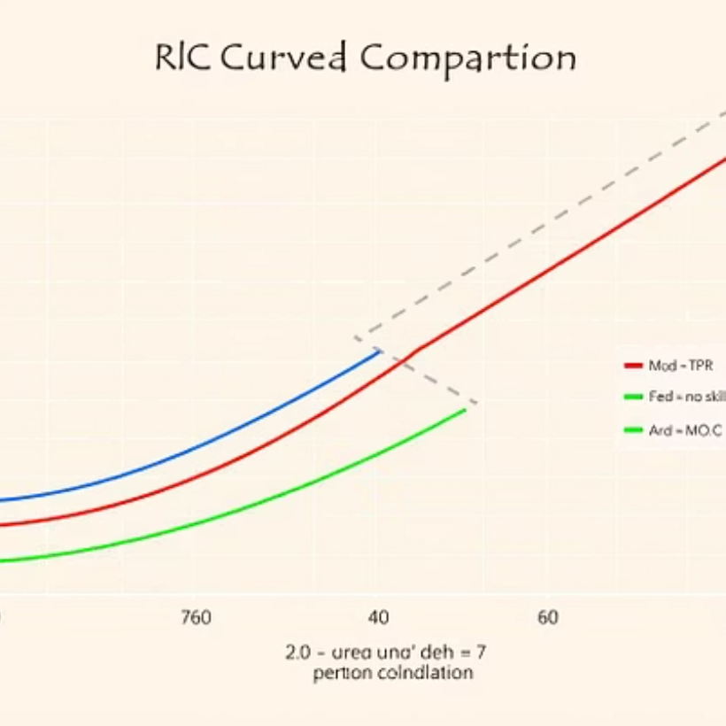

Visual Outputs
A comprehensive suite of visualizations was generated, including Confusion Matrices for each model, Feature Importance plots for Random Forest and XGBoost, and ROC curves comparing all models. An overall model performance comparison chart provides a holistic view. All visual outputs are securely saved in the dedicated outputs folder.

Slide 8



Challenges and Solutions
Severe Class Imbalance
Mitigated effectively using upsampling of the minority class.
Mixed Numerical & Categorical Data
Handled through robust encoding and scaling techniques.
Redundant Features
Removed based on comprehensive variance analysis.

Slide 9
Key Findings
Modular ML Pipeline
Perfect Performance Metrics
Extensible Framework
A clean and modular ML pipeline was successfully implemented.
The pipeline achieves perfect performance metrics on the balanced dataset.
The framework is ready to be extended with new data or additional models.

Slide 10

Future Work
Test pipeline on external datasets to assess generalizability and robustness.
Experiment with advanced techniques like SMOTE or deep learning models.
Package the pipeline as an API or web application for wider use and accessibility.
Document and publish the code and results for reproducibility and community contribution.

